Slide 1
IBM University Engagement Project Submission
“Exploring the Power of Agentic AI with IBM Granite”

Slide 2

Project Tile – [Electricity bill fraud Detection]
Domain of Project – [Electricity bill ]
Student Name | Recent Passport Photo | Email ID | Mobile number [WhatsApp]
Patel Het Ashishkumar |  | hp7511104@gmail.com | 9586613768

Slide 3
Problem Statement - AI Agent for Electricity Bill Fraud Detection
The Challenge
Electricity fraud and billing anomalies lead to major financial losses for power distribution companies. With thousands of consumers and massive billing data, detecting suspicious consumption patterns manually is extremely difficult. Utilities need an intelligent Al system that can automatically analyze electricity usage data and identify potential fraud cases.
The Objective
Build an AI Agent for Electricity Bill Fraud Detection that analyzes electricity consumption and billing records to detect abnormal patterns and flag potential fraud cases.
The solution should:
1. Electricity Consumption Analysis - Analyze consumer electricity usage data to understand normal consumption behavior and trends.
2. Fraud Pattern Identification - Detect suspicious activities such as sudden drops in usage, unusual spikes, or inconsistencies between meter readings and billed units.
3. AI-Based Anomaly Detection - Automatically identify consumers whose usage patterns significantly deviate from normal historical behavior.
4. Explainable AI Insights - Provide clear explanations for why a particular consumer or electricity bill is flagged as suspicious.
Tech Stack (Mandatory)

Slide 4
Proposed Solution - AI-Powered Electricity Bill Fraud Detection Agent
We propose an intelligent AI-powered Electricity Bill Fraud Detection Agent that automatically analyzes electricity consumption and billing records to identify suspicious usage patterns, detect potential fraud, and provide explainable insights to electricity distribution companies.
The system leverages IBM Langflow (or IBM Orchestrate) to automate the complete fraud detection workflow and IBM Granite Models to analyze historical consumption data, detect anomalies, generate fraud explanations, and assist utility officers in making informed decisions.

Slide 5
Technology Used
HTML - is the standard markup language used to create the structure and content of web pages, such as headings, paragraphs, images, and links. It forms the foundation of every website.
CSS is a stylesheet language used to control the appearance and layout of HTML elements, including colors, fonts, spacing, and responsive design, making web pages visually attractive.
JAVASCRIPT - is a programming language used to make web pages interactive and dynamic by adding features like buttons, forms, animations, and real-time updates. It works alongside HTML and CSS to create responsive and engaging websites.

Slide 6

Role of Agentic AI in the solution
Agentic AI serves as the intelligent decision-making core of the Electricity Bill Fraud Detection system. Unlike traditional rule-based systems, it autonomously analyzes historical electricity consumption, billing records, and meter readings to identify abnormal usage patterns and potential fraud. The AI agent continuously monitors incoming data, detects anomalies such as sudden drops or spikes in consumption, inconsistencies between meter readings and billed units, and assigns a fraud risk score to each consumer. It also generates clear, explainable insights describing why a consumer has been flagged and recommends appropriate actions, such as scheduling a meter inspection or conducting a detailed audit. Using IBM Langflow or IBM Orchestrate, the agent automates the complete workflow from data analysis to report generation and alert notifications, reducing manual effort, improving detection accuracy, and enabling faster, data-driven decision making for electricity distribution companies.

Slide 7
Novelty and Uniqueness
Our solution goes beyond traditional rule-based fraud detection by combining Agentic AI, IBM Granite Models, and IBM Langflow/IBM Orchestrate to create an intelligent, self-operating fraud detection system. Instead of relying on fixed thresholds, the AI continuously learns normal electricity consumption patterns from historical data and automatically detects unusual behavior such as sudden usage drops, unexpected spikes, meter-reading inconsistencies, and abnormal billing trends. A key innovation is the use of Explainable AI, which provides clear reasons and supporting evidence for every flagged consumer, enabling utility officers to make confident decisions. The system also assigns a dynamic fraud risk score, prioritizes high-risk cases, automates inspection recommendations, and generates detailed reports without manual intervention. This combination of autonomous decision-making, transparent AI explanations, workflow automation, and intelligent risk prioritization makes the proposed solution more accurate, scalable, and efficient than conventional electricity fraud detection systems.

Slide 8
Git Hub Link
https://github.com/hp7511104-netizen/AI-Agent-for-Electricity-Bill-Fraud-Detection
·

Slide 9
Future Scope
The proposed AI-powered Electricity Bill Fraud Detection system can be further enhanced by integrating real-time smart meter (IoT) data to detect fraud instantly instead of relying only on monthly billing records. Future versions can incorporate advanced machine learning models that continuously learn from new consumption patterns, improving detection accuracy over time. The solution can also be expanded to predict potential fraud before financial losses occur, integrate with GIS for location-based fraud hotspot analysis, and provide mobile applications for field inspectors with real-time alerts and inspection reports. Additionally, the system can support automated customer notifications, blockchain-based secure meter data management, and predictive maintenance for faulty meters. By connecting with national smart grid infrastructure and utility management systems, the platform can evolve into a comprehensive AI-driven energy monitoring and fraud prevention solution that improves operational efficiency, reduces electricity theft, and supports reliable power distribution on a large scale.
·
·
·

Slide 10
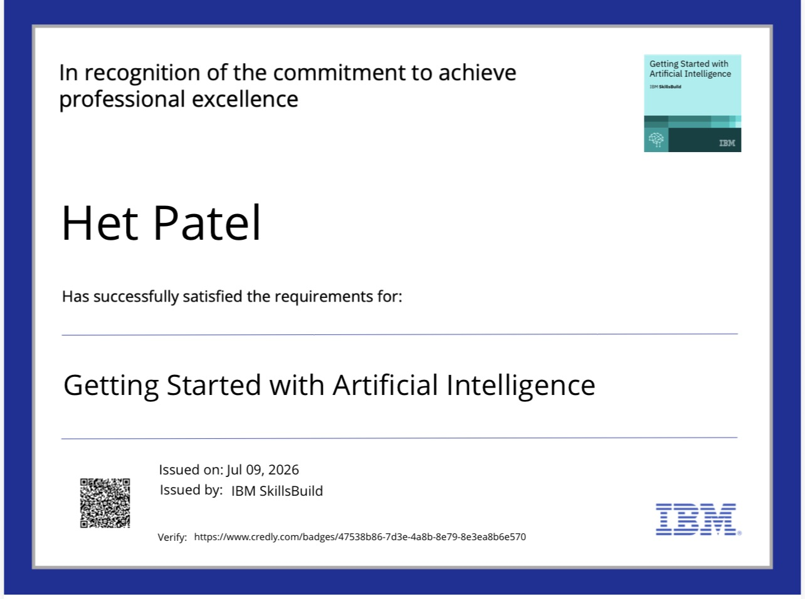
Certificates Earned:

Slide 11
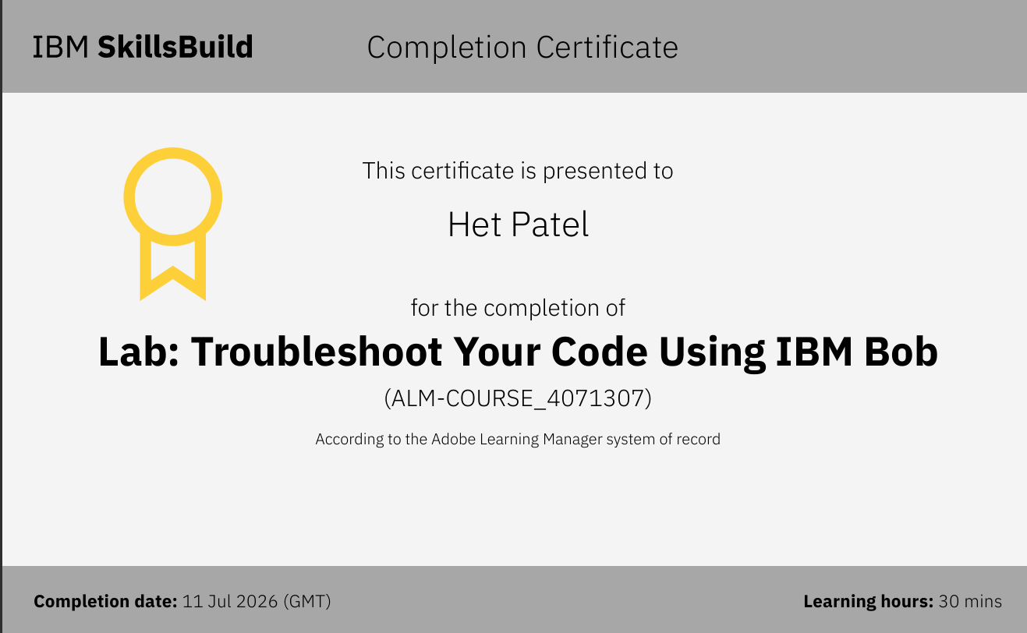
Certificates Earned:​

Slide 12


